Slide 1
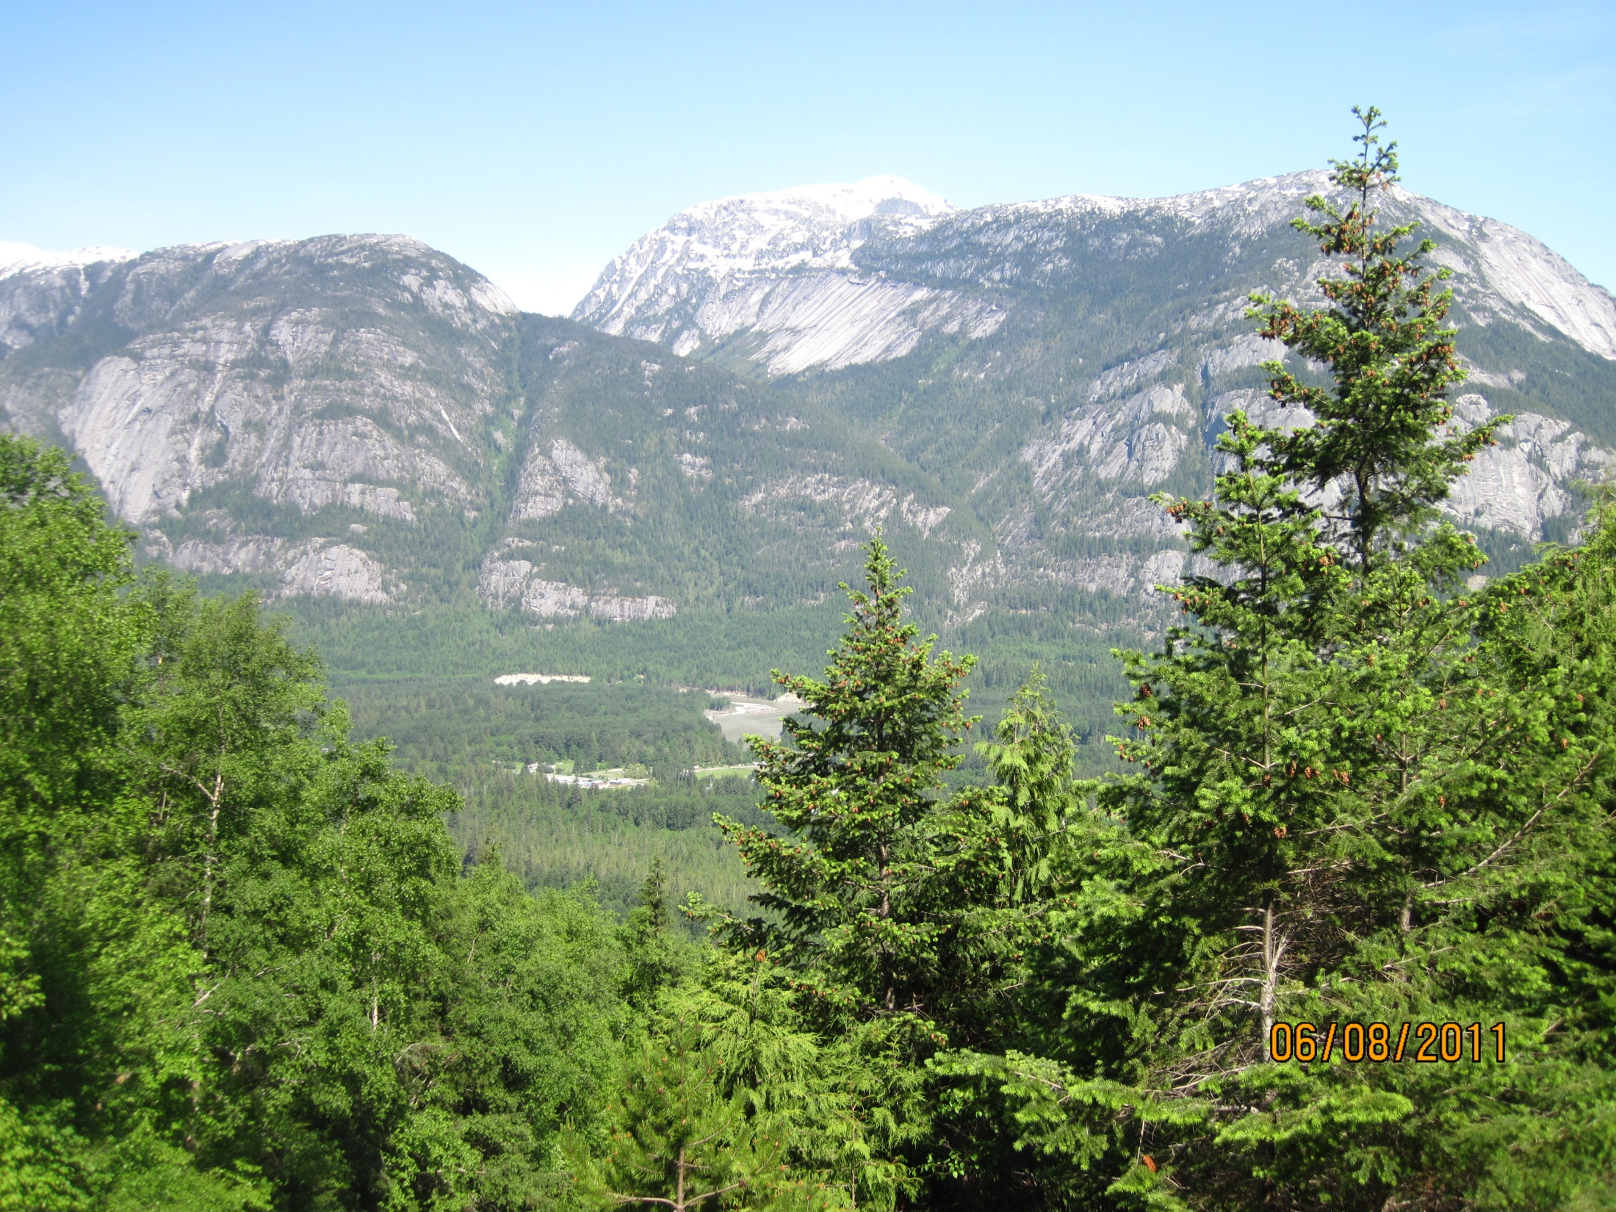


Professional Rationale Workshop
South Island District
Port Alberni, BC
February 15, 2013
Sponsored by the Coast FRPA Implementation Team (CRIT)
Version 2

Slide 2
Welcome and Introduction
Handouts
Agenda
Logistics
Working Group
Notes:
Handouts
Agenda (attached to Outlook invitation)
PowerPoint presentation with speaking notes
Group Discussion #1 and #2 Handout
Response to Parking Lot Issues from the January 25, 2012 Chilliwack workshop
Review Agenda
Emergency Evacuation direction and other logistics
We will record parking lot issues and follow up with answers as needed
If you haven’t done so, please make sure we’ve recorded your participation
Recognize efforts of CRIT working group
Gilbert Richir, FLNR South Island District
Mike Larock, ABCFP
Joe LeBlanc, International Forest Products Ltd.
Introduce presenters

Slide 3
Opening Remarks
History
Objective
Goal
FMLT Messaging
District Experience
Notes:
History of the issue (brief run down on how FMLT and CRIT worked to come to this point).
Objective
Direct - Common understanding of how professional rationales are used to support forest tenure holder and government agency business processes (originally identified in Chilliwack District)
Indirect - Build professional reliance capacity within all coast area districts
Goal for the day (what success looks like). Participants should come away from workshop understanding
Answers to questions/issues identified through the District FMLT or as identified during discussion, e.g. when, what, who, where and why professional rationales are used
Understand how professional rationales support the roles and responsibilities of forest practitioners, e.g. prescribing and reviewing professional, tenure holder and decision maker
Identify tasks and action plans necessary to support professional rationales in your District (as needed).
View from FMLT co-chair perspective
Ask participants to share experience using professional rationales

Slide 4
What is a Professional Rationale?
Underlying foundation of action taken or decision made
An explanation of
  Controlling principles in the circumstances
  Intellectual or sensible path chosen
  Logic toward the expected outcome, opinion or practice.
Provides supporting documentation
Identifies accountability
Reveals the diligence with which the professional undertook the work.
Notes:
Dictionary Definition
1: an explanation of controlling principles of opinion, belief, practice, or phenomena
2: an underlying reason : basis
Synonyms: account, accounting, argument, case, explanation, reason
Rationales usually document (1) why a particular choice was made, (2) how the basis of its selection was developed, (3) why and how the particular information or assumptions were relied on, and (4) why the conclusion is deemed credible or realistic.
Professional Rationale
Provides a framework for developing advice/prescription and planning an activity. The basis from which good forest management decisions are made.
Explain the intent of a decision or prescription so it can be understood and implemented
Support a decision or action
Accountability tool
Regardless of the level of professional experience or how much weight your professional opinion carries, the thought process that goes into a plan, decision or action rationale should be the same. What may differ is the extent of documentation. A professional with less experience will likely need to research and reference more information as part of a rationale compared to a leading expert.

Slide 5
Professional Association Direction
Identified in ABCFP guidelines for interpreting association Bylaws
  Completeness and Correctness Standard
  Safety Standard
  Other Related Bylaws
ABCFP Guidance for Professional Quality Rationales and Comments September 2008
Notes:
Foresters Act Direction and Guidance Specific to Rationale
Bylaw 12.2.2 Completeness and Correctness Standard
Competent members ensure their work is complete, correct and clear.
Guidelines for Interpretation
All work must: Be supported by sufficient rationale so that, where required, others can implement recommendations or prescriptions for action and meet the objectives and commitments embodied in the work;
Bylaw 12.7.1 Safety Standard
Members maintain safe work practices and consider the safety of workers and others in the practice of professional forestry.
Guidelines for Interpretation
The following list describes some measures that members can undertake to meet the ABCFP practice standard and demonstrate their commitment to safety and cultivating a safety culture; Demonstrate consideration for safety (due diligence) in rationales;
Other Related Bylaws supported by Rationales
12.5.1 Members exercise due diligence by being prudent and doing all work with constant and
careful attention.
10.6 Members provide their signature and seal on professional work. This bylaw can extend to peer reviews or ancillary documentation such as a professional rationale.
Web link to ABCFP Guidance for Professional Quality Rationales and Comments - September 2008
http://www.abcfp.ca/regulating_the_profession/documents/Pro_Quality_Rationales.pdf

Slide 6
When is a professional rationale required?
Short Answer – Always
Real Question
When do you need to document a professional rationale?
When do you need to submit or request a professional rationale?
Notes:
Whenever you do professional work.
Always when making a professional decision or taking professional action.
Professional rationales can be thought of as the answers to a series of questions the professional addressed in order to make a professional decision or take a professional action. The challenge is to ensure you are asking the right questions. Once we are comfortable with this, we need to consider;
when do you need to document a professional rationale?
when do you need to submit or request a professional rationale?

Slide 7
Written versus verbal?
Virtually always written (but not necessarily by you)
Built into decision
Written format and extent can vary
  Audience
  Intent
  Risk
Combine verbal and written format
Learning opportunity
Uncertainty
Notes:
Rationale is a demonstration of the thought process used to arrive at a decision, advice, action, etc. If the thought process utilized directed (legislation) or guiding documentation (best management practices) then it is likely reasonable to consider that documentation as the “rationale” behind the decision/action.
Rationale can be built into advice, prescription, work plan etc. if deemed important to successful implementation, i.e. it speaks for itself. If so, it is less likely to require a “documented” rationale.
Written format can vary (formal report, memo/email notification, note to file, diary/journal notes, etc.) depending on intended audience and communication need.
Detail and extent proportional to the degree of risk associated with the advice/decision/action and the degree of departure from professionally acceptable processes/outcomes.
Need to consider who the intended audience is and what the rationale is intended to communicate, e.g. a rationale needed to guide implementation of a prescription far into the future will likely need to be well documented.
Verbal format may be appropriate as means of directing intended audience to use of documented BMP as rationale. Verbal rationale may be used as communication vehicle but documented after the fact for possible future reference, i.e. format includes both verbal and written structure.
Consider development of professional rationale as learning opportunity. Once you have gone through the process a few times, you will get a better sense of when they should be documented and submitted (as well as when no documentation is needed).
Requirement for written decisions and level of detail becomes more obvious after the fact, so it is recommended that a rationale be documented if unsure about need (just in case).

Slide 8
When to submit or request professional rationale?
Key principles
Professionals have right and responsibility consistent with professional obligations.
No requirement to submit rationale for professional work you are not responsible for.
Not entitled to request professional rationale beyond your professional needs.
Examples
FSP development and determination process.
Facilitate implementation of prescription
Peer review
Due diligence
Notes:
Often, it is difficult to determine how a specific element of a FSP meets legislation approval tests when we are dealing with results based commitments. Rather than build an explanation into the plan, a professional rationale can be used to explain how the legal tests have been considered. Submission of the rationale communicates the proponents thoughts and provides the DDM with information to support the determination process.
The prescribing professional may not be available during the implementation of their prescription. It is important to ensure adequate communication of what is expected of the prescription as well as the intent. This will provide the implementing professional with a better opportunity to meet the desire results as well as having the necessary information to be able to make adjustments to the prescription as needed.
Professional decisions, prescriptions, actions, etc. are often based on a collaborative effort between various professionals. It is important to be able to communicate the thought process that went into your professional work if it will be relied upon by another professional.
Professional decisions, prescriptions, actions routinely get called into question by a wide range of interests, e.g. C&E, Forest Practices Board, FREP, stakeholder and public, certification processes, etc.
Anyone can request information related to professional practice and the associated ABCFP professional is obliged to respond to the question within the association’s code of conduct, bylaws, etc. However, the response, as it relates to providing a professional rationale, will vary depending on the circumstances, i.e. the objective of the request. A documented professional rationale may assist the responding professional in developing his/her response but there may be reasons it is only provided in part or not at all, e.g. proprietary rights, technical data too detailed to reasonably address the request, it does not address the objective of the request, etc. The rationale remains the property of the professional to be used at his/her discretion in meeting his/her professional obligations.

Slide 9
What is included in a professional rationale?
Identify decision, advice, activity, etc.
Background information
Alternates considered
Due diligence and professional reliance.
Prediction of possible consequences
Conclusion supporting decision, advice, activity, etc.
Format
Notes:
Identify the decision, advice, practice, activity the rationale is intended to address.
Background information explaining intent of decision (e.g. objectives, guiding direction, background of the circumstance explaining methodologies different from the norm supported by documentation and references).
Alternate courses of action considered and logic for the selected path = the reasonable alternatives available for consideration + diligence in scoping the possibilities
Describe how due diligence and professional reliance was considered
Prediction or evaluation of possible consequences = how do we expect things to unfold; risk; consequences; mitigation
Summary of information that supports effective and efficient decision making.
The developing professional should consider communication objective related to the intended audience and his/her business needs in determining the format, e.g. the format for a note to file will likely be much different than a FSP results or strategy rationale intended to be communicated to a statutory decision maker. For repetitive business processes, e.g. when developing rationale for FPPR s. 97.1, Declaration regarding free growing stand obligations met to the extent practicable, one suggestion is to develop a format template. Other example formats include, formal rational reports, memos, notes to file, email chains, electronic reporting, practice diary, etc.
Note: Not all of these elements are going to be included in every rationale, i.e. it should not be considered a check list. It is more important that the rationale reflect the thought process used by the professional to arrive at a professional decision or action.

Slide 10
What makes an effective professional rationale?
Some helpful hints (see attached speakers notes)
Notes:
Derived from ABCFP guidance document
Identify and speak to target audience
Focus on the types of questions you can anticipate from the target audience
Clear and concise (understandable, readily understood by intended audience)
Be well thought out and encourage understanding (use common sense)
Written objectively (3rd person, independent, without bias, reasonable, risk management)
Avoid specialized technical jargon (use layman language)
Be specific and thorough
Distinguish between science, government policy, observations, assumptions, etc.
Identify compelling components (science, experience) etc and include ancillary documents or references
Identifies and discusses risk management (does not say risk adverse)
Consider follow-up requirements, e.g. monitoring.
Most effective if it accompanies objective, decision, prescription

Slide 11
What to watch out for?
Should not be risk adverse (should recognize and manage risk)
Does not have to guarantee success (should ensure there is opportunity to learn from failures).
Should not be used as a justification tool, i.e. something that inhibits the use of professional reliance.
Is more than your professional opinion
Notes:
Rationales are often used to manage risk to an acceptable level, i.e. the higher the level of risk associated with a plan, decision or action, the more important a rationale becomes. But, while as important as the rationale is in supporting a plan, decision or action commitment, it is not to be confused with the commitment itself. If the commitment results in zero or near zero risk, it is likely that there is no need to develop written rationale.
A professional rationale represents the thought process that supports a resultant plan, decision or action. While the thought process may be documented after the fact, it is a process that occurs prior to the plan, decision or action taking place. After a plan, decision or action occurs, the rationale may also be used to review and understand any discrepancy between anticipated and actual outcomes. However, a rationale is not a tool for building a case supporting a desired outcome after the fact.
The rationale represents a professionals due diligence which can be demonstrated in a variety of ways. Professional opinion and experience are valid and important components of a professional rationale but are usually supported by additional elements, e.g. monitoring/research results, risk assessments, stakeholder input, etc.

Slide 12
FSP Development, Review and Approval Process
Professional rationales support the roles and responsibilities of the;
Tenure holder
Prescribing professional
Reviewing professional
Decision maker
Notes:
The decision to document and submit a rationale as part of the FSP review and approval process is based on the needs of the identified audience. Understanding who your audience is and their needs will provide your best means of understanding when to document, how much to include and when to submit a professional rationale.
It is important to take off your business hat. As a professional employee you have responsibilities to your employer/client. These are obvious day-to-day and absolutely essential. You also have responsibilities to your profession. The application of a minimum knowledge, independent thought and advice, exercising diligence, and a commitment to stewardship. These are the reasons the legislature has created the profession. If you can’t do these everyday then the public benefit is lost.
The tenure holder is a client of the professional(s) involved in the process. He/she has an interest in understanding why a FSP submission was written the way it was as well as why it was rejected (if that is the case).
The prescribing professional is responsible to ensure his/her client (the tenure holder) is fully aware of what is being committed to and why when signing a FSP submission. Questions from the reviewing professional or the decision maker relative to their respective roles and responsibilities may be used by the prescribing professional to supplement his/her rationale.
The reviewing forester’s role is to ensure that the DDM is fully armed with information sufficient to allow him/her to make the legal determination. The output of the review process is in essence, the baseline information for the decision makers determination rationale. While the reviewing professional may need to question the prescribing professional about his/her submission, any request for submission of a documented rationale should be made after consulting with the DDM.
Depending on the nature of the issues relevant to the FSP decision, the decision maker will often let the output of the review process stand on its own as the rationale for the decision. In some cases, the decision maker may wish to document a decision rationale to address all or portions of the FSP decision, e.g. FN consultation considerations. Note: The DDM may request additional information (within legal authority to do so) to support his/her determination. The prescribing professionals rationale (if not already submitted) may be used to support this request.
Note: FRPA s. 16(3) that a decision maker must give written reasons for refusing to approve a FSP, WLP or an amendment to either.

Slide 13
Forest Stewardship Plan Stocking Standard Amendment Example
CWH xm within Forest Stewardship Plan
Understanding PR
Roles and Responsibilities
Rationale
Accountability
Field Review
Risk
Notes:
Issue CWH vm1 classification is actually CWH xm
Submitting Professional
Field assessment (abundance dull Oregon grape) and photos
Reviewed biogeoclimatic maps
Reviewed Land Management Handbook #28 CWH xm descriptions and CWH vm1
Stand dominated by Fdc and Hw
Reviewed records of other blocks in area with similar outcomes and scenarios
Reviewed Stocking Standard reference guide for CWH xm footnote that in wetter portion of biogeoclimatic unit that western Hw is a major species
Mean annual precipitation measured at weather station 25km away
Risk addressed through small component of larger FDU
Regeneration established through planting Fdc and Cw
Due diligence and rationale documented
Reviewing Professionals
Technical discussion
Probing questions – what was considered
Risk is addressed
Discussions clarified in email from submitting professional
Statutory Decision Maker
DDM is comfortable with clarification
Amendment was approved

Slide 14
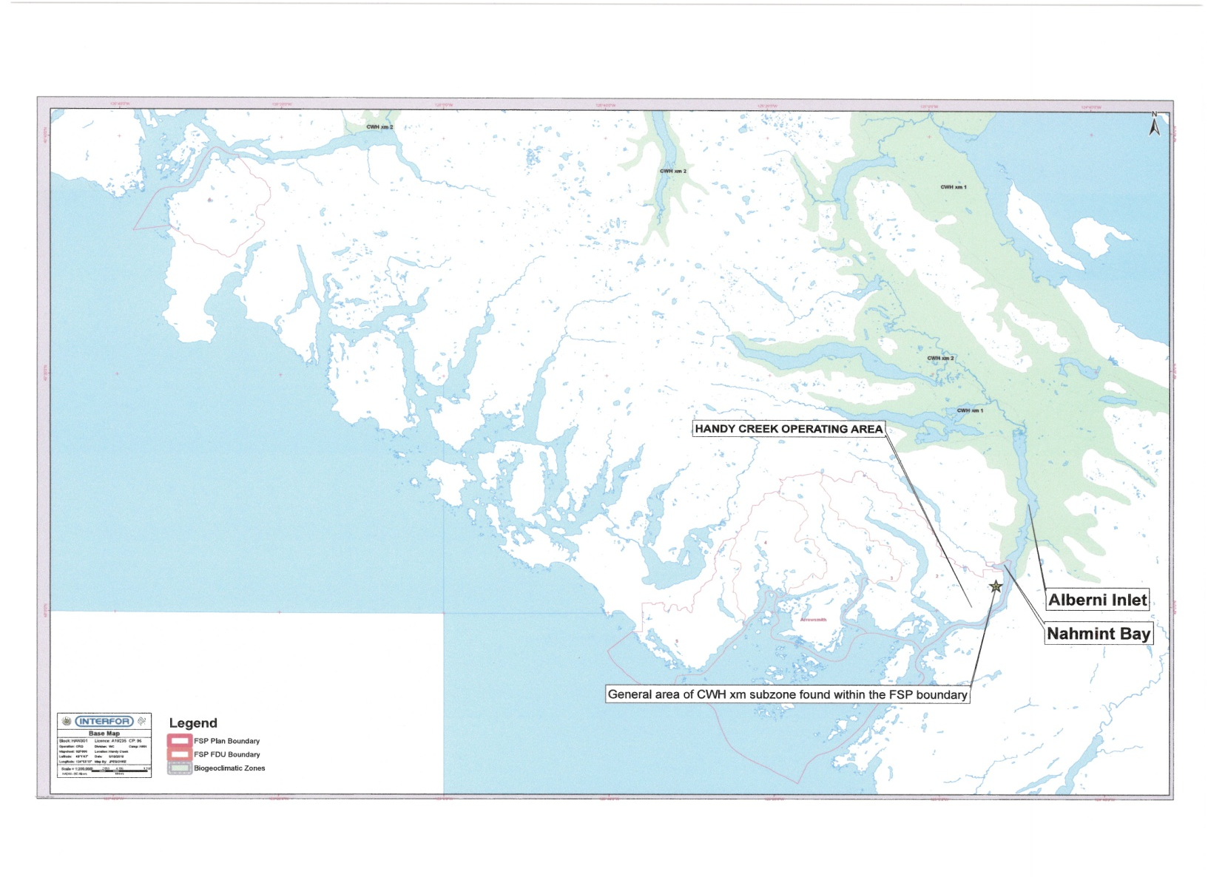
CWH xm within Forest Stewardship Plan Example (continued)
Notes:
Risk
Represents < 1% of Forest Stewardship Area

Slide 15
Group Discussion #1
Professional Rationale Check-In
Questions (handout)
What is a professional rationale?
Why is a professional rationale needed?
Who is responsible a professional rationale?
When would you document a professional rationale?
Where would you submit or request a professional rationale?
Notes:
Form groups of 6-8 people with mix of participants (agency, licensee, consultants, etc).
Based on the presentation material, your experience and the check-in questions, within your group have a discussion aimed at addressing the following questions. Be prepared to provide feedback to the broader group. (30 minutes)
What did you learn that will make you better informed about professional rationales?
Is there anything in the presentation messaging that you disagree with or needs clarification?
What elements of the professional rationale discussion was missing?
What additional professional rationale support is needed?
What is the variety of ways to provide a professional rationale?
Pick preferred and back up scenario for break out session #2 professional rationale writing exercise. Feel free to develop local scenario.
Be prepared to identify your scenario as part of group discussion #1 report out.

Slide 16
Group Discussion #2
Professional Rationale Writing Exercise (handout)
Form discussion group (6-8 people)
Pick example scenario/question review
Identify and prepare to report out to the broader group
  Professional rationale audience and their information needs
  Assumptions you built into the scenario
  Critical elements of professional rationale
Notes:
Use previous groups
Move to designated breakout room/table
Using your identified scenario, identify and be prepared to report out on the following three questions
Who is the audience and what are their information needs under your scenario?
What assumptions are built into your scenario, e.g. Known information, direction already in place, etc.?
What are the critical elements of professional rationale supporting your scenario?
Review scenario as a group and document report out response (three questions on slide)
Designate group speaker and report out to larger group

Slide 17
Summary
Professional rationale is the response to a series of questions that must be addressed in order to make a professional decision.
Decision to document and submit/request rationale is dependent on your target audience needs.
Consider your role and responsibility when developing or requesting professional rationale.

Slide 18
Next Steps and Workshop Review
Action items
Parking lot Items
Other questions?
Review goals for the day
For more information go to;
http://www.for.gov.bc.ca/rco/stewardship/CRIT/index.htm
Thank you
Notes:
Identify action item/task, who will address and by when.
Identify strategy to address parking lot issues.
Goals for the day
Answers to questions/issues identified through the District FMLT, e.g. when, what, who, where and why professional rationales are used
Understand how professional rationales support the roles and responsibilities of forest practitioners, e.g. prescribing and reviewing professional, tenure holder and decision maker
Identify tasks and action plans necessary to support professional rationales in your district (as needed).

